Slide 1
Component props and state management

Slide 2
Component Properties
Use props to send data to components.
Every component is treated as a pure javascript function.
Props are equivalent to parameters of a pure javascript function.
Props are immutable. Because these are developed in the concept of pure functions. In pure functions we cannot change the data of parameters. So, also cannot change the data of a prop in ReactJS.
We do not need to use this for function based components to access props but we have to use this to access props (this.props[‘prop_name’]).
Notes:
props (short for properties) are a Component's configuration, its options if you may. They are received from above and immutable as far as the Component receiving them is concerned.
A Component cannot change its props, but it is responsible for putting together the props of its child Components.

Slide 3
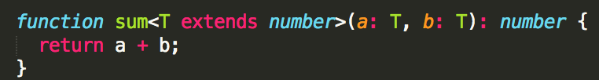
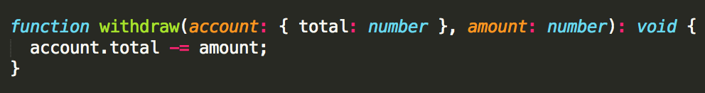
Props are Read-Only
Whether you declare a component as function or class, it must never modify its own props:
In contrast, this function is impure because it changes its own input:
All React components must act like pure functions with respect to their props.

Slide 4
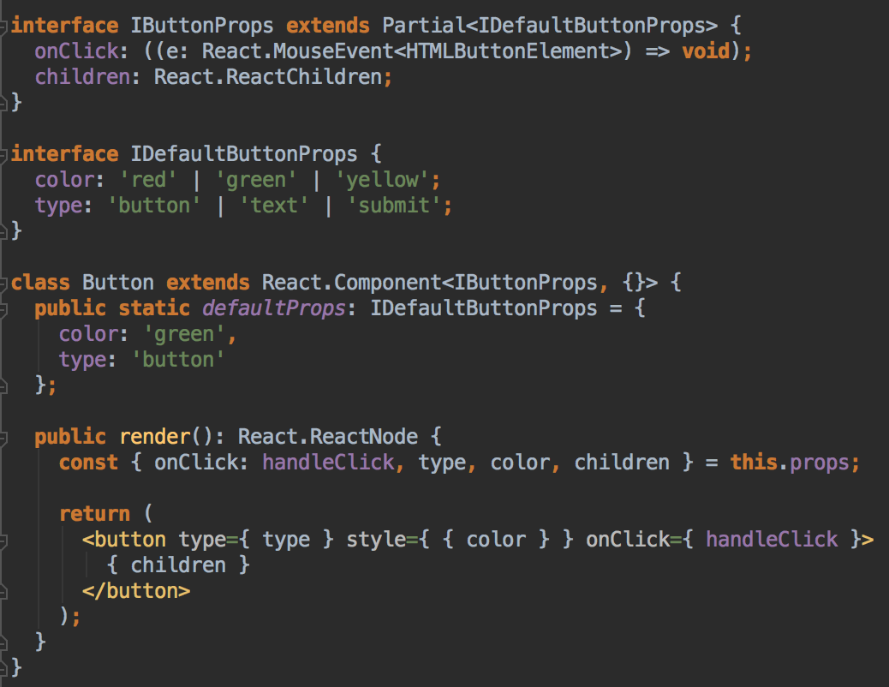
DefaultProps
Notes:
The defaultProps will be used to ensure that this.props.color and this.props.type will have a value if it was not specified by the parent component.

Slide 5
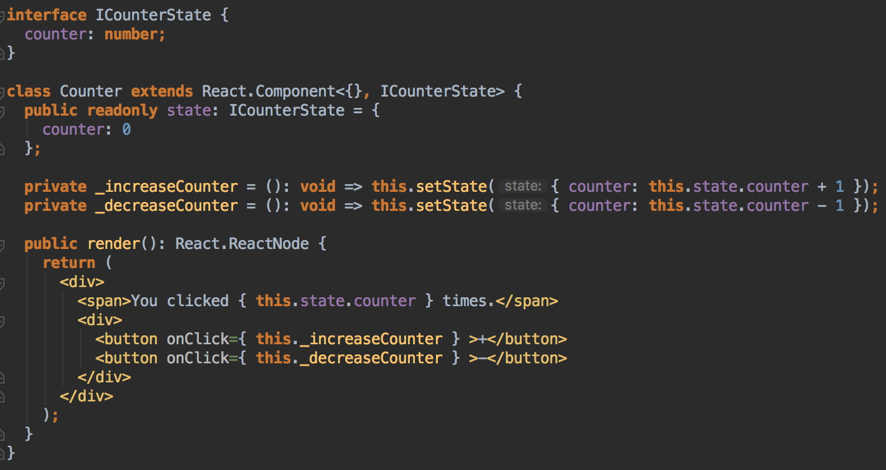
Component State
Notes:
State is the place where the data comes from. We should always try to make our state as simple as possible and minimize the number of stateful components. If we have, for example, ten components that need data from the state, we should create one container component that will keep the state for all of them.

Slide 6
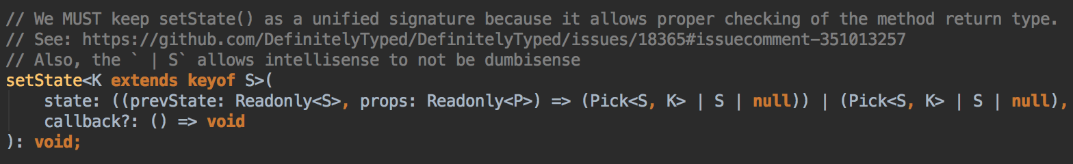
Component State
setState() does not always immediately update the component.
Use componentDidUpdate or a setState callback (setState(updater, callback)), either of which are guaranteed to fire after the update has been applied.
Notes:
setState() enqueues changes to the component state and tells React that this component and its children need to be re-rendered with the updated state. This is the primary method you use to update the user interface in response to event handlers and server responses.
Think of setState() as a request rather than an immediate command to update the component. For better perceived performance, React may delay it, and then update several components in a single pass. React does not guarantee that the state changes are applied immediately.
setState() will always lead to a re-render unless shouldComponentUpdate() returns false. If mutable objects are being used and conditional rendering logic cannot be implemented in shouldComponentUpdate(), calling setState() only when the new state differs from the previous state will avoid unnecessary re-renders.

Slide 7

The first argument of setState() is an updater function with the signature:
Both state and props received by the updater function are guaranteed to be up-to-date. The output of the updater is shallowly merged with state.
Notes:
state is a reference to the component state at the time the change is being applied. It should not be directly mutated. Instead, changes should be represented by building a new object based on the input from state and props. For instance, suppose we wanted to increment a value in state by props.step:

Slide 8

The second parameter to setState() is an optional callback function that will be executed once setState is completed and the component is re-rendered. Generally we recommend using componentDidUpdate() for such logic instead.
You may optionally pass an object as the first argument to setState() instead of a function:

Slide 9
What does setState do?
setState() schedules an update to a component’s state object. When state changes, the component responds by re-rendering.

Slide 10
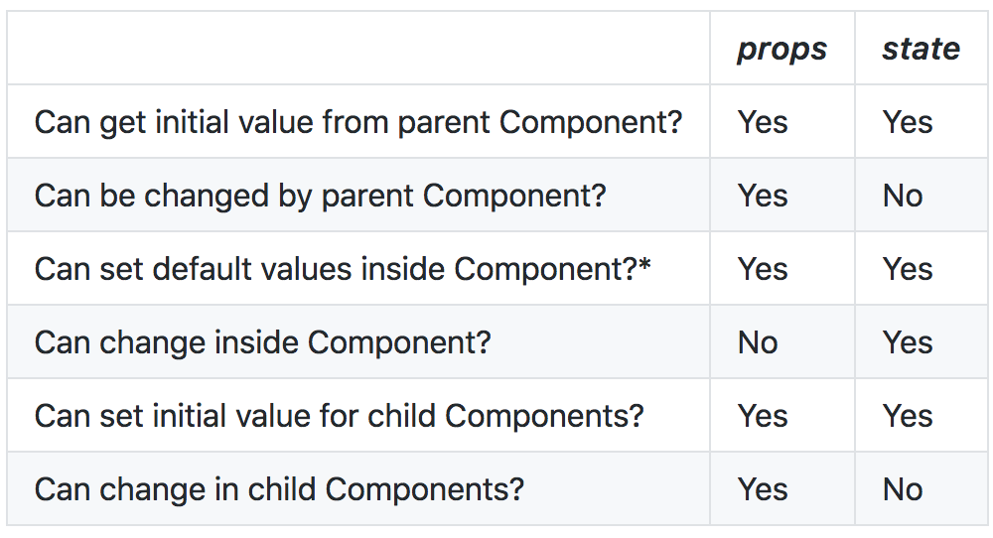
What is the difference between state and props?
Notes:
props (short for “properties”) and state are both plain JavaScript objects. While both hold information that influences the output of render, they are different in one important way: props get passed to the component (similar to function parameters) whereas state is managed within the component (similar to variables declared within a function).

Slide 11
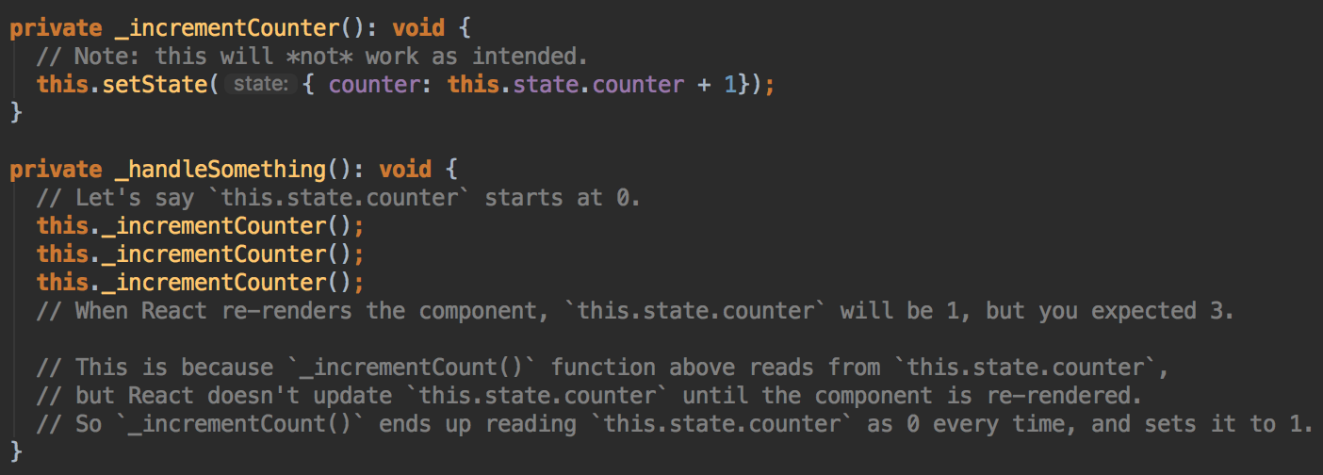
Why is setState giving me the wrong value?

Slide 12
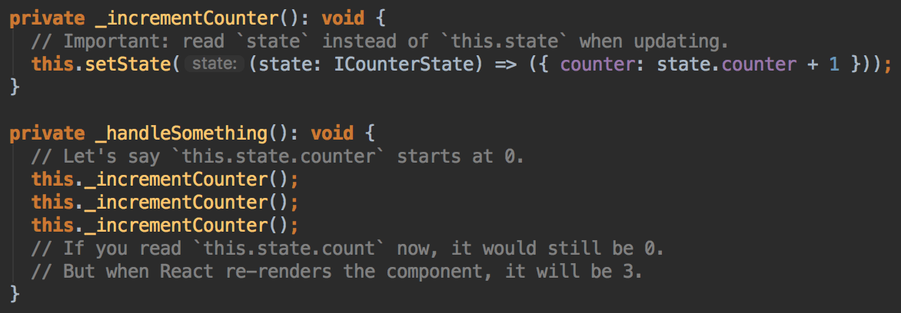
What is the difference between passing an object or a function in setState?
Notes:
Passing an update function allows you to access the current state value inside the updater. Since setState calls are batched, this lets you chain updates and ensure they build on top of each other instead of conflicting:

Slide 13
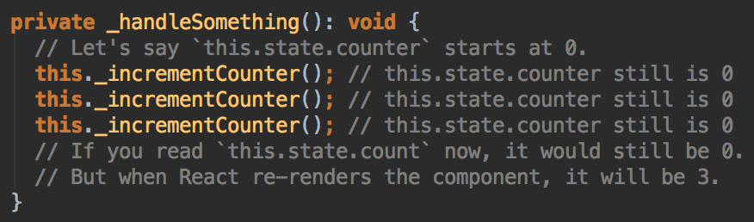
When is setState asynchronous?
Currently, setState is asynchronous inside event handlers.
Notes:
This ensures, for example, that if both Parent and Child call setState during a click event, Child isn’t re-rendered twice. Instead, React “flushes” the state updates at the end of the browser event. This results in significant performance improvements in larger apps.

Slide 14
Why doesn’t React update this.state synchronously?
There are two main reasons:
This would break the consistency between props and state, causing issues that are very hard to debug.
This would make some of the new features React team is working on impossible to implement.
Notes:
React intentionally “waits” until all components call setState() in their event handlers before starting to re-render. This boosts performance by avoiding unnecessary re-renders.

Slide 15
Do we have an alternative of state in React environment?
Yes! We can use state management library like:
Flux
Redux
Mobx
Mobx State Tree

